Slide 1
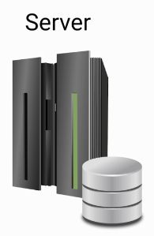


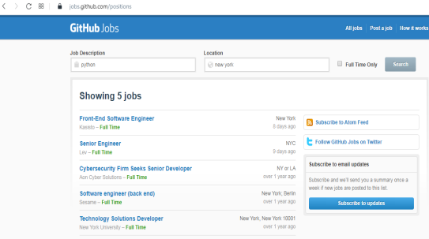

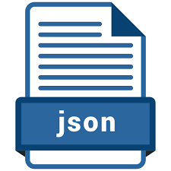
Web Server Vs. API Server
Github Job Application
Client
Program to generate HTML
Search Program
Program to query the database
API Program

